Slide 1

Understanding and Addressing Mental Health
BY SOFOLA FOLAKUNMI ABIDEMI

Slide 2
ASK PHASE
My datasets include individuals of various genders with mental health issues, spanning different regions and causes of mental health problems, as well as whether they have received any form of treatment.
I aim to identify the primary causes of mental health issues in different countries, assess the prevalence of mental health and treatment.

Slide 3
PREPARE PHASE
My source of dataset is secondary data, I got it from KAGGLE. The dataset link is :
https://www.kaggle.com/datasets/bhavikjikadara/mental-health-dataset

Slide 4
PROCESS PHASE
With my dataset, This were the questions I answered on SQL for cleaning the data
What is the the datatype for each columns using queries?
What are the missing values in the datasets?
How many occupations do we have in the datasets ?
Separate the timestamp column into two separate columns (Date and Time).
Add new columns separate DATE into year, month, day of week and Time into hours, minutes and seconds

Slide 5
ANALYZE PHASE
I used Tableau in analyzing my work , using this
1) Days spent indoors due to increasing stress levels
2) Work Intreat due to mental health history
3) Gender in relation to social weakness
4) Care option and family history in relation to gender
5) Mental health history and treatment in relation to occupation
5) Displaying coping struggle across occupations by mood swings

Slide 6
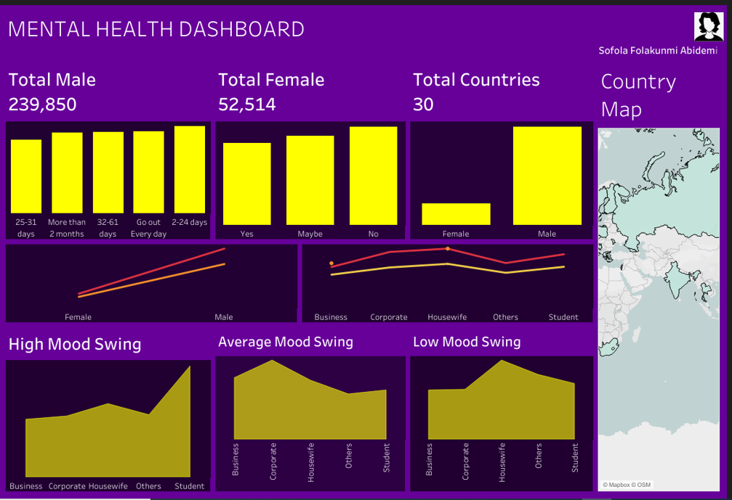
Visual Representation of My Results

Slide 7
SHARE PHASE: RESULTS
The longer you stay at home, the higher your stress levels become.
People who lack interest in working are more likely to have a history of mental health issues.
Males exhibit greater social weakness, which may be linked to their mental health.
"Men are more likely to have a family history of mental health issues.
Both genders are equally likely to seek care when experiencing mental health problems.
Housewives have a higher prevalence of mental health history, while business owners have the lowest.
Most people do not seek treatment as expected.
Students experience the most significant coping struggles and mood swings, whereas housewives experience the least.

Slide 8
SHARE PHASE: RECOMMENTATION
It's better to stay active than to remain indoors doing nothing.
Men should enhance their social lives, especially by speaking up during difficult times.
Everyone should seek help or treatment when experiencing any mental health issues.
The workload for students should be reduced.

